Slide 1
Structured Query Language
By: Mohamed Essam

Slide 2


Slide 3

What is SQL
SQL (pronounced “ess-que-el”) stands for Structured Query Language. SQL is used to communicate with a database. According to ANSI (American National Standards Institute), it is the standard language for relational database management systems. SQL statements are used to perform tasks such as update data on a database, or retrieve data from a database. Some common relational database management systems that use SQL are: Oracle, Sybase, Microsoft SQL Server, Access, Ingres, etc.

Slide 4
What is SQL
Although most database systems use SQL, most of them also have their own additional proprietary extensions that are usually only used on their system. However, the standard SQL commands such as “Select”, “Insert”, “Update”, “Delete”, “Create”, and “Drop” can be used to accomplish almost everything that one needs to do with a database. This tutorial will provide you with the instruction on the basics of each of these commands as well as allow you to put them to practice using the SQL Interpreter.

Slide 5

SQL

Slide 6
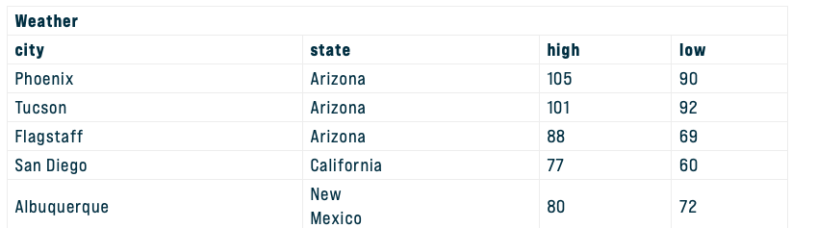
Table Basics
A relational database system contains one or more objects called tables. The data or information for the database are stored in these tables. Tables are uniquely identified by their names and are comprised of columns and rows. Columns contain the column name, data type, and any other attributes for the column. Rows contain the records or data for the columns. Here is a sample table called “weather”.

Slide 7
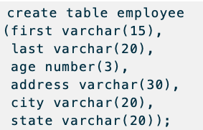
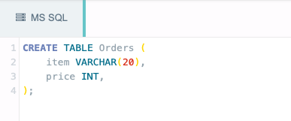
SQL - Create Table
Using the SQL CREATE TABLE statement you can create a table in a database.

Slide 8
SQL - Datatype
INT − A normal-sized integer that can be signed or unsigned. If signed, the allowable range is from -2147483648 to 2147483647. If unsigned, the allowable range is from 0 to 4294967295. You can specify a width of up to 11 digits.
VARCHAR(M) − A variable-length string between 1 and 255 characters in length. For example, VARCHAR(25). You must define a length when creating a VARCHAR field.
DATE − A date in YYYY-MM-DD format, between 1000-01-01 and 9999-12-31. For example, December 30th, 1973 would be stored as 1973-12-30.
TIMESTAMP − A timestamp between midnight, January 1st, 1970 and sometime in 2037. This looks like the previous DATETIME format, only without the hyphens between numbers; 3:30 in the afternoon on December 30th, 1973 would be stored as 19731230153000 ( YYYYMMDDHHMMSS ).

Slide 9
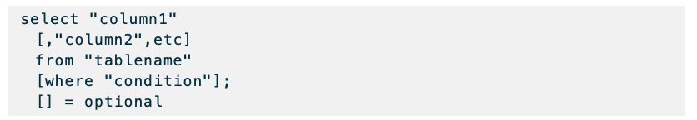
SQL – Selecting Statement
The select statement is used to query the database and retrieve selected data that match the criteria that you specify. Here is the format of a simple select statement:

Slide 10
SQL – Selecting Statement
The column names that follow the select keyword determine which columns will be returned in the results. You can select as many column names that you’d like, or you can use a “*” to select all columns.
The table name that follows the keyword from specifies the table that will be queried to retrieve the desired results.
The where clause (optional) specifies which data values or rows will be returned or displayed, based on the criteria described after the keyword where.

Slide 11
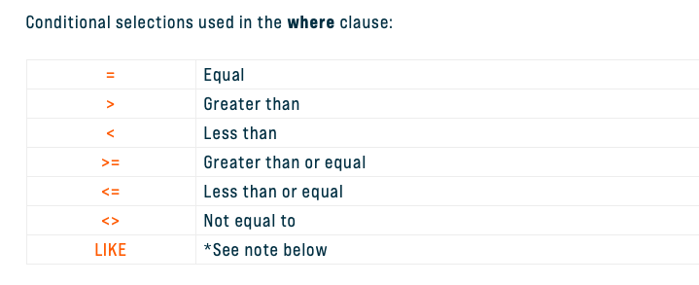
SQL – Selecting Statement

Slide 12
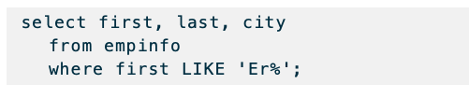
SQL – Selecting Statement
The LIKE pattern matching operator can also be used in the conditional selection of the where clause. Like is a very powerful operator that allows you to select only rows that are “like” what you specify. The percent sign “%” can be used as a wild card to match any possible character that might appear before or after the characters specified. For example:
This SQL statement will match any first names that start with ‘Er’. Strings must be in single quotes.

Slide 13
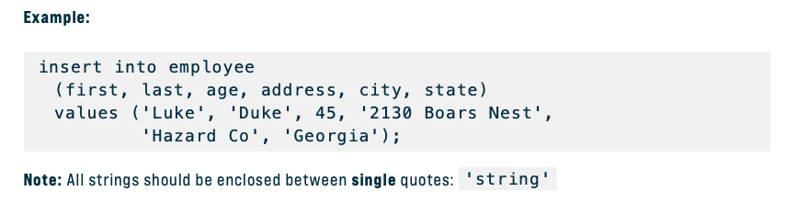
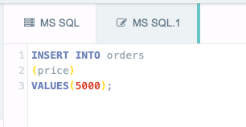
SQL – Insert Statement

Slide 14
SQL – Insert Statement
To insert records into a table, enter the key words insert into followed by the table name, followed by an open parenthesis, followed by a list of column names separated by commas, followed by a closing parenthesis, followed by the keyword values, followed by the list of values enclosed in parenthesis. The values that you enter will be held in the rows and they will match up with the column names that you specify. Strings should be enclosed in single quotes, and numbers should not.

Slide 15
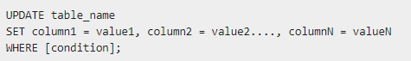
SQL – Update Statement
The update statement is used to update or change records that match a specified criteria. This is accomplished by carefully constructing a where clause.

Slide 16
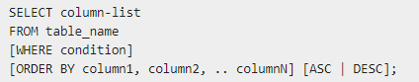
SQL - Order By

Slide 17

SQL - Delete Data

Slide 18
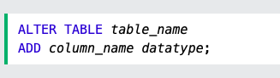
ALTER TABLE - ADD Column
The ALTER TABLE statement is used to add, delete, or modify columns in an existing table.
The ALTER TABLE statement is also used to add and drop various constraints on an existing table.

Slide 19
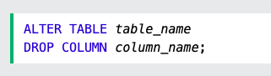
ALTER TABLE - Drop Column
The ALTER TABLE statement is used to add, delete, or modify columns in an existing table.
The ALTER TABLE statement is also used to add and drop various constraints on an existing table.

Slide 20
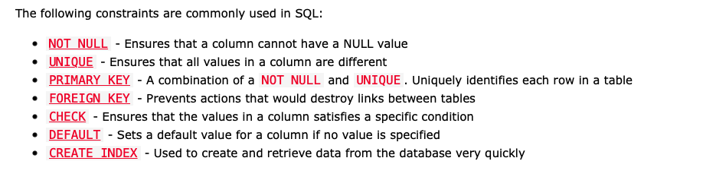
SQL Constraints
SQL constraints are used to specify rules for the data in a table.
Constraints are used to limit the type of data that can go into a table. This ensures the accuracy and reliability of the data in the table. If there is any violation between the constraint and the data action, the action is aborted.

Slide 21
SQL Auto Increment
CREATE TABLE Persons ( Personid int NOT NULL AUTO_INCREMENT, LastName varchar(255) NOT NULL, FirstName varchar(255), Age int, PRIMARY KEY (Personid) );
Or
Personid int IDENTITY(1,1) PRIMARY KEY,

Slide 22
SQL Not Null
CREATE TABLE Persons ( ID int NOT NULL, LastName varchar(255) NOT NULL, FirstName varchar(255) NOT NULL, Age int );

Slide 23
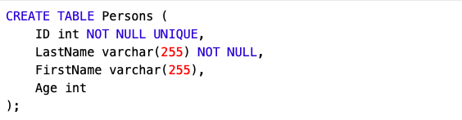
SQL UNIQUE Constraint
The UNIQUE constraint ensures that all values in a column are different.
Both the UNIQUE and PRIMARY KEY constraints provide a guarantee for uniqueness for a column or set of columns.
A PRIMARY KEY constraint automatically has a UNIQUE constraint.
However, you can have many UNIQUE constraints per table, but only one PRIMARY KEY constraint per table.

Slide 24
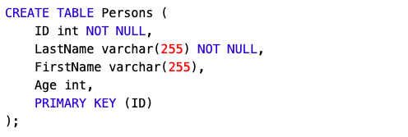
SQL PRIMARY KEY Constraint
The PRIMARY KEY constraint uniquely identifies each record in a table.
Primary keys must contain UNIQUE values, and cannot contain NULL values.
A table can have only ONE primary key; and in the table, this primary key can consist of single or multiple columns (fields).

Slide 25
SQL Foreign KEY Constraint
The FOREIGN KEY constraint is used to prevent actions that would destroy links between tables.
A FOREIGN KEY is a field (or collection of fields) in one table, that refers to the PRIMARY KEY in another table.
The table with the foreign key is called the child table, and the table with the primary key is called the referenced or parent table.

Slide 26
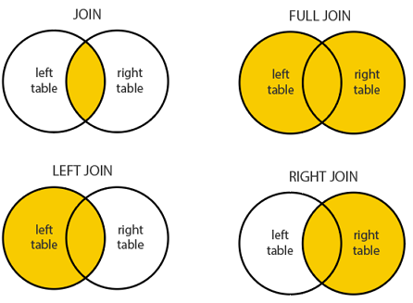
SQL Joins
SQL JOIN
A JOIN clause is used to combine rows from two or more tables, based on a related column between them.
Let's look at a selection from the "Orders" table:

Slide 27
An Entity Relationship (ER) Diagram is a type of flowchart that illustrates how “entities” such as people, objects or concepts relate to each other within a system. ER Diagrams are most often used to design or debug relational databases in the fields of software engineering, business information systems, education and research. Also known as ERDs or ER Models, they use a defined set of symbols such as rectangles, diamonds, ovals and connecting lines to depict the interconnectedness of entities, relationships and their attributes. They mirror grammatical structure, with entities as nouns and relationships as verbs.
What is an ER diagram?

Slide 28
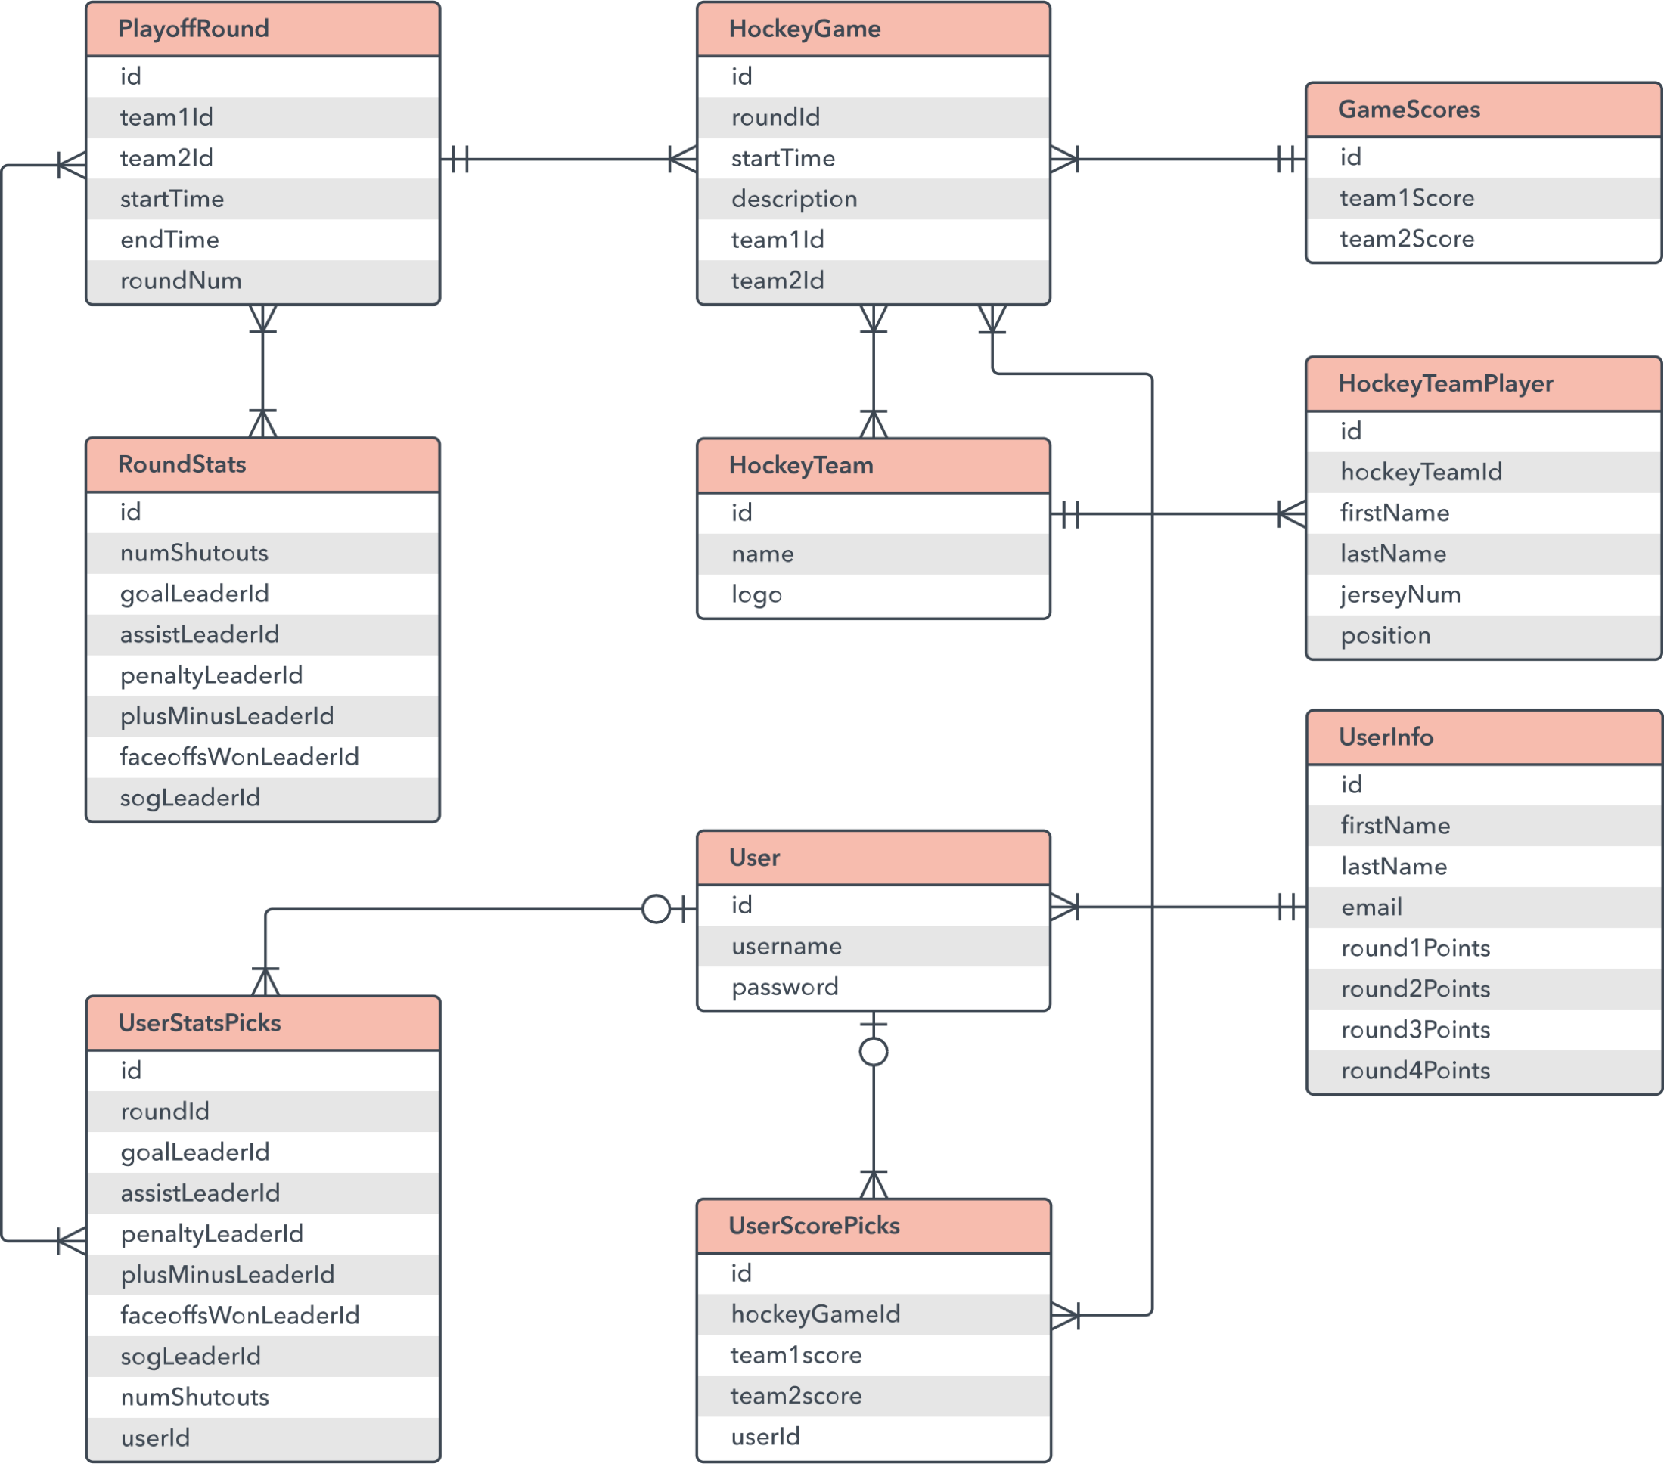
What is an ER diagram?

